Slide 1
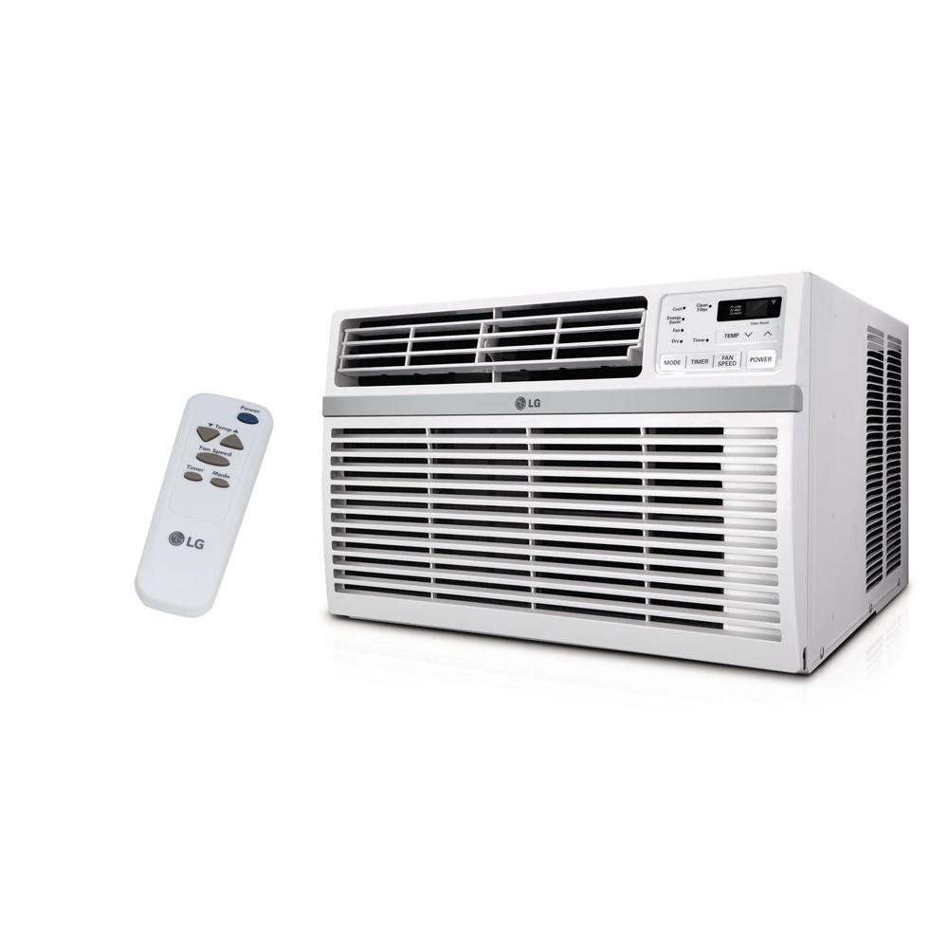
Looping / Iteration
Repeating a set of instruction for a period of time

Slide 2
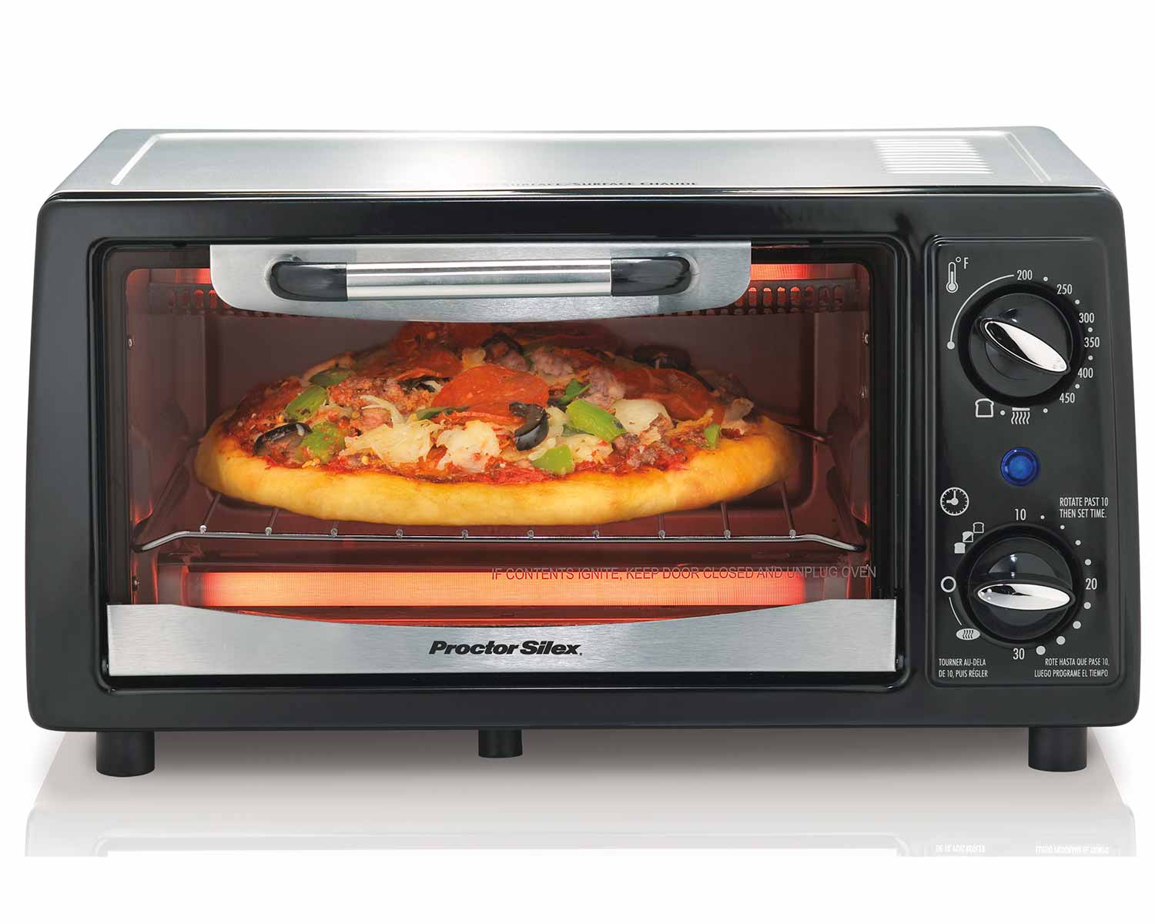
Looping / Iteration
Repeating a set of instruction for a period of time

Slide 3
Looping
Loops are iterative statements
Block of statements are repeatedly executed as long as condition is true
Infinite loop
Finite loop
Type of loops
Notes:
Condition given in loop must become false after some ﬁnite iterations otherwise its a inﬁnite loop
•Values used in condition must update inside the body of ﬁnite loop
Four types of loops • •
pre-tested loop while() •
post-tested loop do..while() •
counter controlled loop for() •
for each loop for Collections for()

Slide 4
Types of Loops
Pre-tested loop
Post-tested loop
Counter controlled loop
Notes:
Condition given in loop must become false after some ﬁnite iterations otherwise its a inﬁnite loop
•Values used in condition must update inside the body of ﬁnite loop
Four types of loops • •
pre-tested loop while() •
post-tested loop do..while() •
counter controlled loop for() •
for each loop for Collections for()

Slide 5

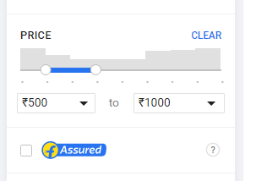

Looping / Iteration
Notes:
How will you write this in programming ?

Slide 6
// Pseudocode
Repeat If(Price >= 500 && Price <= 1000)
{
Display the bag;
}
while(Price >= 500 && Price <= 1000)
{
Display the bag;
}
1
2
3
4
5
6
7
8
9
10
11
12
13
14
15
16
17
18
19
20
21
22
Notes:
Repeat If statement is nothing but the while condition

Slide 7
Question 1
Print 1 to N
Sample Input:
Sample Output:
10
1 2 3 4 5 6 7 8 9 10

Slide 8
// Pseudocode
number = 1
Repeat If(Number <= N)
{
Print Number;
Number++;
}
1
2
3
4
5
6
7
8
9
10
11
12
13
14
15
16
17
18
19
20
21
22

Slide 9
While Loop
Condition is checked first, then loop body will be executed.
If condition is false, loop body will not be executed.
Entry controlled loop
Notes:
Title + Bullets
No more than 4 points. Please use another similar slide incase you have more points.

Slide 10
While Loop
Syntax:
while (condition)
{
//body of the loop
Increment/ Decrement
}

Slide 11
// Code
#include<iostream>
using namespace std;
int main()
{
int N;
cin >> N;
int number = 1;
while(number <= N)
{
cout << number;
number++;
}
return 0;
}
1
2
3
4
5
6
7
8
9
10
11
12
13
14
15
16
17
18
19
20
21
22

Slide 12
// Pseudocode
number = 1
Repeat If(Number <= N)
{
Print Number;
Number++;
}
for(number = 1; number <= N; number++)
{
Print Number;
}
1
2
3
4
5
6
7
8
9
10
11
12
13
14
15
16
17
18
19
20
21
22
Notes:
Ask the students whether there is any other format to write this program.
While condition will increase the number of lines
Whereas for condition is used to decrease the number of lines as it is given in one line itself.

Slide 13
For Loop
1
2
4
for(initialization/ declaration; condition; increment/decrement)
{
//Body of the Loop
}
3
Syntax:

Slide 14
// Code to print numbers from 1 to N
include<stdio.h>
int main()
{
int N;
cin >> N;
for(int number = 1; number <= N; number++)
{
cout << number;
}
return 0;
}
1
2
3
4
5
6
7
8
9
10
11
12
13
14
15
16
17
18
19
20
21
22
Notes:
Ask the students whether there is any other format to write this program.
While condition will increase the number of lines
Whereas for condition is used to decrease the number of lines as it is given in one line itself.

Slide 15
Question 2
Count the Number of digits
Sample Input:
Sample Output:
44
2

Slide 16
// Pseudocoode
Input: N
count = 0
Repeat If (N > 0)
{
count++
N = N / 10
}
Print count
1
2
3
4
5
6
7
8
9
10
11
12
13
14
15
16
17
18
19
20
21
22
Notes:
Now if my Input is 0, Output should be 1
But when I execute this code my output will not be 1
So how to rewrite this code

Slide 17
// Pseudocoode
Input: N
count = 0
If(N == 0)
{
Print “1”
}
Else
{
Repeat If (N > 0)
{
count++
N = N / 10
}
Print count
}
1
2
3
4
5
6
7
8
9
10
11
12
13
14
15
16
17
18
19
20
21
22
Notes:
Without If how will you write this program??

Slide 18
// Pseudocoode
Input: N
count = 0
Do
{
count++
N = N / 10
}while(N > 0);
Print count
1
2
3
4
5
6
7
8
9
10
11
12
13
14
15
16
17
18
19
20
21
22
Notes:
Without If how will you write this program??

Slide 19
Do While Loop
Loop body will be executed first, then condition is checked
If condition is false, loop body will be executed at least once
Exit controlled loop
Notes:
Title + Bullets
No more than 4 points. Please use another similar slide incase you have more points.

Slide 20
Do While Loop
Syntax:
Do
{
//statement
}while(condition);

Slide 21
// Code
#include<iostream>
using namespace std;
int main()
{
int N;
cin >> N;
int count = 0;
do
{
count ++;
N = N /10;
}while(N > 0);
cout << count;
return 0;
}
1
2
3
4
5
6
7
8
9
10
11
12
13
14
15
16
17
18
19
20
21
22
Notes:
Without If how will you write this program??

Slide 22
break
No further statements in the body of the loop are executed
Loop is immediately terminated
Control immediately goes to the statement following the loop construct
Notes:
Title + Bullets
No more than 4 points. Please use another similar slide incase you have more points.

Slide 23
#include<iostream>
using namespace std;
int main()
{
for(int i = 1; i <= 10; i++)
{
if(i == 5)
{
break;
}
cout << i;
}
return 0;
}
1
2
3
4
5
6
7
8
9
10
11
12
13
14
15
1234
Output

Slide 24
continue
No further statements in the body of loop are executed
Control immediately goes directly to the beginning of the loop for the next iteration
Notes:
Title + Bullets
No more than 4 points. Please use another similar slide incase you have more points.

Slide 25
#include<iostream>
using namespace std;
int main()
{
for(int i = 1; i <= 10; i++)
{
if(i == 5)
{
continue;
}
cout << i;
}
return 0;
}
1
2
3
4
5
6
7
8
9
10
11
12
13
14
15
1234678910
Output

Slide 26
Range based for loop
for(var_type var_name : sequence)
statement; // can use var_name
for(var_type var_name : sequence)
{
statements; // can use var_name
}
Notes:
Title + Text

Slide 27
#include<iostream>
using namespace std;
int main()
{
int scores[] {100,90,87};
for(int score : scores)
{
cout << score << endl;
}
return 0;
}
1
2
3
4
5
6
7
8
9
10
11
12
13
14
15
100
90
87
Output

Slide 28
#include<iostream>
using namespace std;
int main()
{
int scores[] {100,90,87};
for(auto score : scores)
{
cout << score << endl;
}
return 0;
}
1
2
3
4
5
6
7
8
9
10
11
12
13
14
15
100
90
87
Output

Slide 29
#include<iostream>
using namespace std;
int main()
{
string s = "Hello";
for(char s1 : s)
{
cout << s1 << endl;
}
return 0;
}
1
2
3
4
5
6
7
8
9
10
11
12
13
14
15
H
e
l
l
o
Output

Slide 30
#include<iostream>
using namespace std;
int main()
{
string s = “ABC";
for(int s1 : s)
{
cout << s1 << endl;
}
return 0;
}
1
2
3
4
5
6
7
8
9
10
11
12
13
14
15
65
66
67
Output

